Slide 1
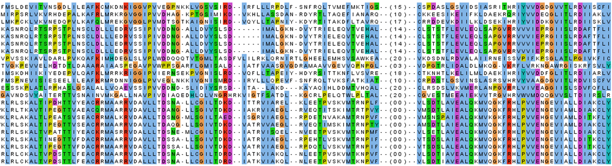

Example for a phenetic technique: UPGMA
(Unweighted Pair Group Method with Arithmetic Mean)
1) Alignment
2) Distance matrix

Slide 2
First Step
PAM distance 3.3 (Human - Monkey) is the minimum. So we'll join Human and Monkey to MonHum and we'll calculate the new distances.
Mon-Hum
Mosquito
Spinach
Rice
Human
Monkey

Slide 3
Calculation of new distances
After we have joined two species in a subtree we have to compute the distances from every other node to the new subtree. We do this with a simple average of distances:
Dist[Spinach, MonHum]
= (Dist[Spinach, Monkey] + Dist[Spinach, Human])/2
= (90.8 + 86.3)/2 = 88.55
Mon-Hum
Spinach
Human
Monkey

Slide 4
Next cycle
Mos-(Mon-Hum)
Mon-Hum
Rice
Spinach
Mosquito
Human
Monkey

Slide 5
Last joining
(Spin-Rice)-(Mos-(Mon-Hum))
Mos-(Mon-Hum)
Spin-Rice
Mon-Hum
Rice
Spinach
Mosquito
Human
Monkey

Slide 6
Example for a cladistic technique: Maximum Likelihood
The likelihood is the probability of the data given the model
The probability of observing the data under the assumed model will change depending on the parameter values of the model.
The aim of maximum likelihood is to choose the value of the parameter that maximizes the probability of finding the data.

Slide 7
What is an evolutionary model in this context ?
“an empirical matrix describing the relative rates of amino acid replacements”
Dayhoff matrix (Dayhoff et al., 1978)
JTT matrix (Jones et al., 1992)
mtREV matrix (Adachi and Hasegawa, 1996)
WAG matrix (Whelan and Goldman, 2001).
Typically, the model has additional free ‘parameters’:
The rate of evolution can vary across parts of the tree
The rate of evolution can vary from site to site in the protein

Slide 8
How is maximum likelihood computed ?
T
T
A
G
2) Compute the likelihood of each path
T
T
A
G
ATGC
ATGC
T
G
ATGC
G
L(path) = L(root) x Π L(branches)
=P(G→T)P(G→G) P(G→A)P(G→G) […]
1) Image all ancestral possibilities
and evolutionary paths.
3) multiply all likelihoods
over all possible paths
4) throughout, do not forget to
optimize all free parameters
5) Repeat for each tree
topology, identify the one
with best Likelihood

Slide 9
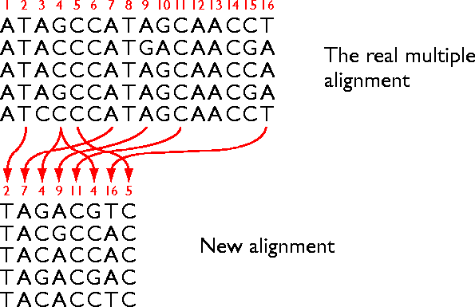
How do we verify a tree?
Difficult ! Very few trees are actually known with certainty
Simulation
Bootstrapping

